Slide 1
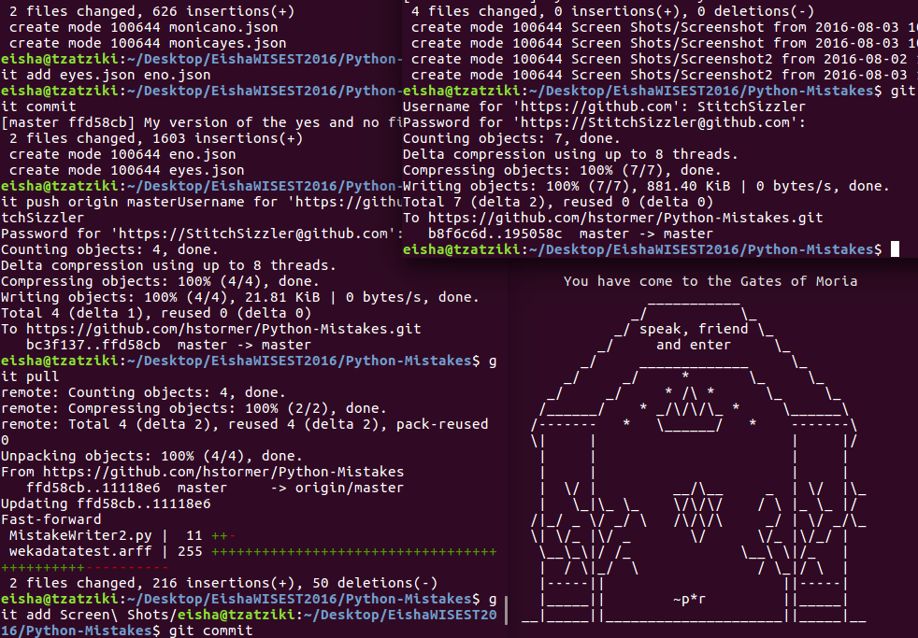
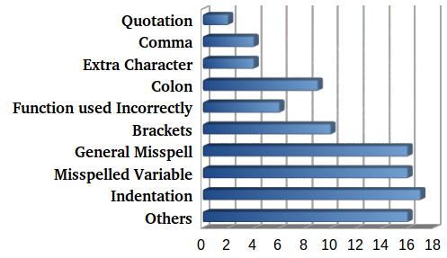
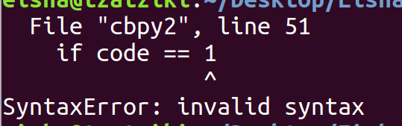
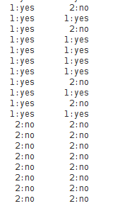

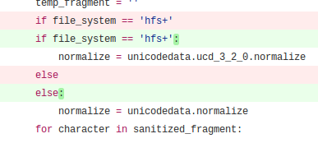



Detecting Programming Errors Using Machine Learning
Eisha Ahmed, Joshua Campbell, Andrea McIntosh, Dr. Abram Hindle
Department of Computer Science, University of Alberta
What is Python?
Python is a widely used programming language used to do tedious and repetitve tasks.
One small error, such as an extra bracket or missed indentation, can cause the program to break
Research Purpose
Find breaks and errors in other programmers’ codes.
The collected data will be used to better locate any errors that future programmers might make in their code.
Procedure
Used GitHub to collect sample coding data .
Fed the collected data to Weka so the computer can use the sample mistakes to learn to locate errors.
Results
Some types of errors occur more frequently than others.
Examples of common types of errors and their frequencies. Generally, Indentation errors happen to occur more frequently.
We managed to get our predictions to reach ~75% accuracy. The results can be used to help future programmers find errors in their code.
Acknowledgements
Special thanks to:
        WISEST and HIP students, Hannah Stormer and Monica Bui.
        Joshua Campbell for supervising the lab, Andrea McIntosh for her support, and Principle Investigator Dr. Abram Hindle.
        Sponsor Canada Summer Jobs
        WISEST 2016 reasearch program
Some of the data was obtained in collaboration with other WISEST and HIP students.
Terminal Window displaying syntax error
Methodology used to train the computer in mistake classification
Actual value of data
Prediction by computer
Examples of classification results from Weka. A prediction is correct if the two instances match: yes is classified as yes and no is classified as no
Original Text with error
A Sample Mistake: forgetting the colon after an if or else statement may result in a break in program
Correct predictions
Corrected Version
Incorrect predictions

